Slide 1
Clinical Updates, Critical Discussions
Meeting Highlights on CDK 4/6 Inhibitors in HR+/HER2- Breast Cancer
Joyce A. O’Shaughnessy, MD
Celebrating Women Chair in Breast Cancer Research
Baylor University Medical Center
Director, Breast Cancer Research Program
Texas Oncology
Dallas, Texas, United States

Slide 2
George W. Sledge Jr, MD
Professor of Medicine
Stanford University School of Medicine
Stanford, California, United States
Wolfgang Janni, MD, PhD
Professor and Chair, Department of Obstetrics and Gynecology
University of Ulm
Ulm, Germany

Slide 3
Early Breast Cancer

Slide 4

Case: Maria M
57-year-old patient, lump right breast
Mammography
BIRADS 4 lesion
3 cm nipple-areola complex distance
Lesion diameter: 8 mm
Breast ultrasound
BIRADS 4 lesion
Correlating, 9 mm diameter
Axillary lymph node un-suspicious
Sonography-guided core needle biopsy performed

Slide 5
Case: Maria M
Core needle biopsy
NST, Grade 3, L0, V0 ER4, P0, Her2-neu negative Ki67-40%
cT1b cN0 M0
Breast-conserving therapy, sentinel lymph node excision
Pathology report
pT1c (16 mm), pN0, G3, Ki67 35%, ER 70%, PR 40%, HER2 neg
Oncotype diagnosis: RS 42
BRCA1 positive
4 cycles EC-chemotherapy, 12 doses paclitaxel, followed by adjuvant radiotherapy and endocrine therapy

Slide 6
Case: Maria M
Core needle biopsy
NST, Grade 3, L0, V0 ER4, P0, Her2-neu negative Ki67-40%
cT1b cN0 M0
Breast-conserving therapy, sentinel lymph node excision
Pathology report
pT1c (16 mm), pN0, G3, Ki67 35%, ER 70%, PR 40%, HER2-neg
Oncotype diagnosis: RS 42
BRCA1 positive
4 cycles EC-chemotherapy, 12 doses paclitaxel, followed by adjuvant radiotherapy and endocrine therapy
What will be the standard for the endocrine therapy after ASCO® 2021?

Slide 7
Algorithum for HR+/HER2- Early Breast Cancer
Luminal A-like (ER+ and/or PR+, HER2– and low proliferation)
Luminal B-like (ER+ and/or PR+, HER2– and high proliferation)
Surgery with or without adjuvant radiation therapy
High risk of recurrence
NO
YES
Endocrine therapy alone
Chemotherapy (neoadjuvant or adjuvant)
Anthracycline–taxane sequence, or docetaxel and cyclophosphamide (if low tumor burden (pN0–1))
In all luminal-like tumors: adjuvant endocrine therapy (minimum 5 years; if high-risk, extended for up to 7–10 years)
Premenopausal women: tamoxifen; if high-risk: GnRH analogue and tamoxifen or aromatase inhibitor
Postmenopausal women: aromatase inhibitor and/or tamoxifen upfront or in sequence with each other
Under investigation: CDK4/6 inhibitor plus endocrine therapy
In postmenopausal women or premenopausal women receiving ovarian suppression
Consider adjuvant bisphosphonates
Harbeck N, et al. Nat Rev Dis Primers. 2019;5:66.
Notes:
Harbeck N, Penault-Llorca F, Cortes J, et al. Breast cancer. Nat Rev Dis Primers. 2019 Sep 23;5(1):66. doi: 10.1038/s41572-019-0111-2. PMID: 31548545.

Slide 8
HR+/HER2- Early Breast Cancer Adjuvant Phase 3 Trials with a CDK 4/6 Inhibitors in Luminal Early Breast Cancer
RESULTS DISCLOSED
AWAITING RESULTS
TRIALS ONGOING OPEN FOR RECRUITMENT
Trial | PALLAS | PENELOPE B | MONARCH E | NATALEE | ADAPT^{CYCLE} | ADAPT^{LATE}
Enrollment | 5760 (m,f) | 1250 (f) | 5637 (m,f) | 4000 (m,f) | 1670 (f) 5600 screened | 903 (f) 1250 screened
CDK4/6i, dose/d | Palbociclib₁₂₅ | Palbociclib₁₂₅ | Abemaciclib₁₅₀ BID | Ribociclib₄₀₀ | Ribociclib₆₀₀ | Abemaciclib₁₅₀ BID
Schedule | 3 weeks on 1 week off | 3 weeks on 1 week off | continuous | 3 weeks on 1 week off | 3 weeks on 1 week off | continuous
Duration | 2 years | 1 year (after nonpCR) | 2 years | 3 years | 2 years (vs chemo) | 2 years (2–6 y after primary diagnosis)
Primary Endpoint | iDFS | iDFS | iDFS | iDFS | DFS; 5 y dDDF > 92% | iDFS
Results | negative [2019] | negative [2020] | positive | ongoing | ongoing | Ongoing
Harbeck N. Curr Opin Obstet Gynecol 2021;33:53–58.
Notes:
Harbeck N. Risk-adapted adjuvant therapy of luminal early breast cancer in 2020. Curr Opin Obstet Gynecol. 2021;33:53-58. doi: 10.1097/GCO.0000000000000679. PMID: 33337614.

Slide 9
PENELOPE-B: Study Design
Study of palbociclib + ET in HR-positive, HER2-negative primary BC + high relapse risk after NAC
Eligibility Criteria
Residual invasive disease postNC in breast or lymph nodes
Centrally confirmed HR+/HER2-
CPS-EG score ≥ 3 or 2 and ypN+
Identifies high risk of relapse after NAC using clinical stage, pathologic stage, grade and ER
Patients with a CPS-EG score 3 or 2 with ypN+ (~ 25%) have a 3-year DFS of 77%
NC ≥ 16 wk (and 6 wk taxane)
< 16 wk since final surgery or < 10 wk from completing RT
N = 1250
HR-pos/HER2-neg breast cancer
No pCR after NAC
CPS-EG score ≥ 3 or ≥ 2 with ypN+
Primary Endpoint: iDFS
Stratification Factors
Nodal status: ypN 0 to 1 vs ypN2 to 3
Age: ≤ 50 vs > 50 years
Ki-67: > 15% vs ≤ 15%
Region: Asian vs non-Asian
CPS-EG Score: ≥ 3 vs 2 and ypN+
Palcociclib
125 mg once daily PO d1-21, q28d for 13 cycles
Neoadjuvant Chemotherapy
Surgery +/- Radiotherapy
R 1:1
Placebo
d1-21, q28d for 13 cycles
All patients will receive concomitantly endocrine therapy according to local standards
Primary Endpoint: iDFS
Secondary Endpoints: iDFS excluding second primary invasive non-breast cancers, distant DFS, locoregional recurrence free interval, OS, safety, compliance
Loibl S, et al. SABCS 2020. Abstract GS1-02.
Notes:
Loibl S, Marmé f, Martin, M, et al. Phase III study of palbociclib combined with endocrine therapy (ET) in patients with hormone-receptor-positive (HR+), HER2-negative primary breast cancer and with high relapse risk after neoadjuvant chemotherapy (NACT): First results from PENELOPE-B . San Antonio Breast Cancer Symposium;December 8-11, 2020; San Antonio, TX. Abstract GS01-02.

Slide 10
PENELOPE-B: Results
IDFS and OS Median follow-up: 42.8 months
Primary Endpoint: iDFS
OS (Interim Analysis)
Loibl S, et al. SABCS 2020. Abstract GS1-02.

Slide 11
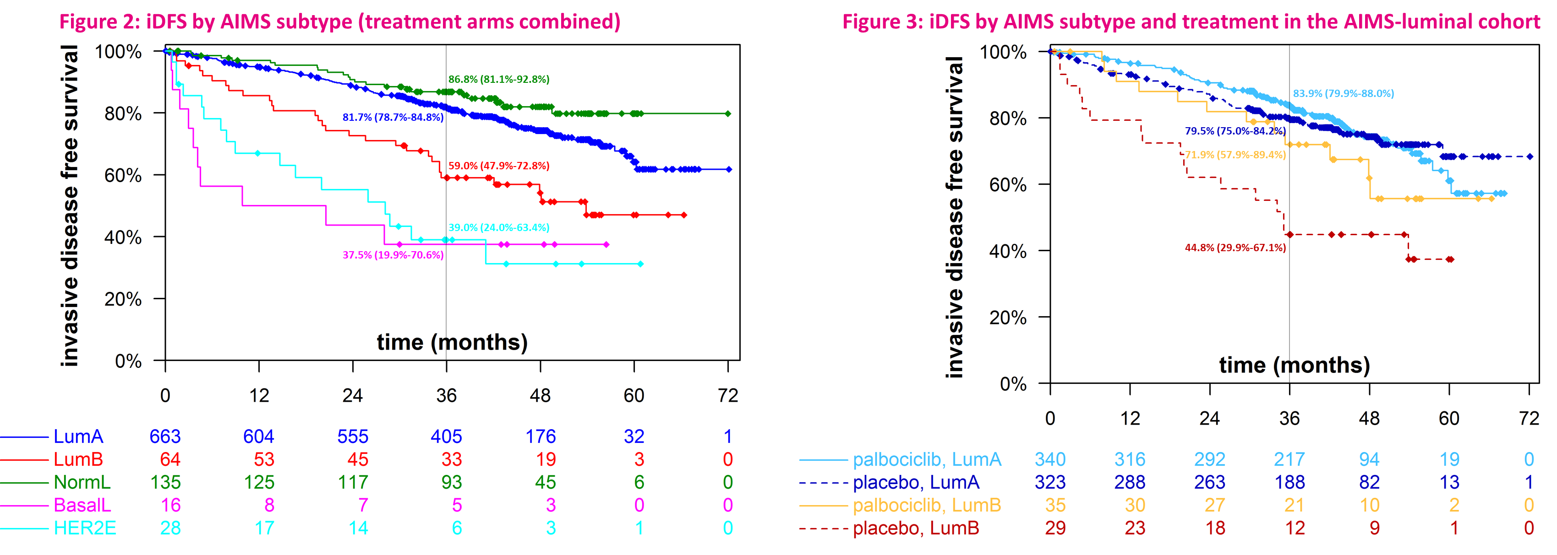
PENELOPE-B: Subgroup Postneoadjuvant Luminal B Tumors Assessed by HTG
.
Small group of patients with a luminal-B tumor after NAC (n = 64) potentially derived benefit from palbociclib (numerically, not statistically significant)
Further investigation is required in a larger cohort to validate a palbociclib benefit that might be confined to this group
Denkert C, et al. Presented at: ASCO 2021. Abstract 519
Notes:
Denkert C, Marmé F, Martin M, et al. Subgroup of post-neoadjuvant luminal-B tumors assessed by HTG in PENELOPE-B investigating palbociclib in high risk HER2-/HR+ breast cancer with residual disease. Presented at: ASCO 2021 Annual Meeting; June 4-8, 2021. Abstract 519.

Slide 12
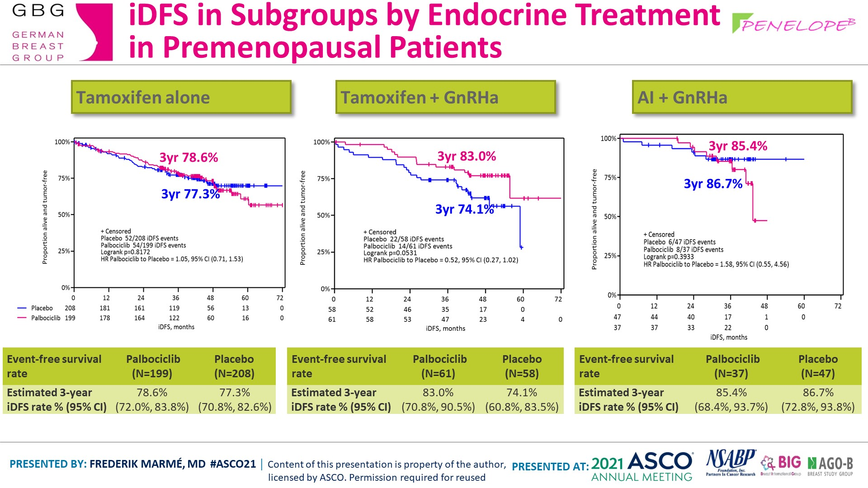
PENELOPE-B : Subgroup Analyses of Premenopausal Patients
First safety results from a phase III study for the combination tamoxifen +/-GnRHa and palbociclib
Although the overall results did not show improvement in 3-year iDFS, an improvement was seen in the small subgroup of premenopausal women receiving tamoxifen + GnRHa
Addition of palbociclib to tamoxifen +/-GnRH in premenopausal women did not increase side effects compared to AI+GnRH and seems to be an alternative to AI+GnRHa
Marme F, et al. ASCO 2021. Abstract 518.
Notes:
Marmé F, Martin M, Untch M, et al. Palbociclib combined with endocrine treatment in breast cancer patients with high relapse risk after neoadjuvant chemotherapy: Subgroup analyses of premenopausal patients in PENELOPE-B. ASCO 2021 Annual Meeting; June 4-8, 2021. Abstract 518.

Slide 13
PALLAS: Results
At a median follow-up of 23.7 mo, no significant difference in either 3-y iDFS or DRFS was observed 42% early discontinuation (64% due to AEs), 32% complete 2 y
IDFS
DRFS
 | Palbociclib + ET | ET Alone
iDFS | 88.2% | 88.5%
HR 0.93, 95% CI 0.76, 1.15; log-rank P = .51
 | Palbociclib + ET | ET Alone
dRFS | 89.3% | 90.7%
HR 1.00, 95% CI 0.79, 1.27; log-rank P = .9997
Mayer E, et al. ESMO Virtual 2020. Abstract LBA12.
Notes:
Mayer E, et al. PALLAS: A randomized phase III trial of adjuvant palbociclib with endocrine therapy versus endocrine therapy alone for HR+/HER2- early breast cancer. Presented at: European Society for Medical Oncology (ESMO) congress. Virtual 2020. Abstract LBA12.
DRFS = distant recurrence-free survival

Slide 14
monarchE: Study Design
Cohort 1: Inclusion based on clinicopathological risk factors:
≥ 4 ALN OR
1 to 3 ALN and at least 1 of the below:
Histologic grade 3
Tumor size ≥ 5 cm
N = 5637
Abemaciclib (150 mg twice daily for up to 2 years)
+ Standard of care endocrine therapy
(5 to 10 years as clinically indicated)
HR-positive, HER2-, node-positive high risk early breast cancer
ITT includes both C1 and C2
R
1:1
Standard of care endocrine therapy (5 to 10 years as clinically indicated)
Cohort 2: Inclusion based on Ki-67:
1 to 3 ALN and
Centrally tested Ki-67 ≥ 20%^{d}
No Grade 3 and tumor size not ≥ 5 cm
Stratified for:
Prior chemotherapy
Menopausal status
Region
Other criteria:
Women or men
Pre-/ post-menopausal
With or without prior neo- and/or adjuvant chemotherapy
No distant metastasis
Maximum of 16 months from surgery to randomization and 12 weeks of ET following the last non-ET
Primary Objective: IDFS (STEEP criteria)
Key Secondary Objectives: IDFS in Ki-67 high (≥ 20%) population, DRFS, OS, safety, patient reported outcomes, and pharmacokinetics
O'Shaughnessy J, et al. SABCS 2020. Abstract GS1-01.
Notes:
O’Shaughnessy JA, Johnston S, Harbeck N, et al. Primary outcome analysis of invasive disease-free survival for monarchE: abemaciclib combined with adjuvant endocrine therapy for high risk early breast cancer. San Antonio Breast Cancer Symposium;December 8-11, 2020; San Antonio, TX. Abstract GS01-01.

Slide 15
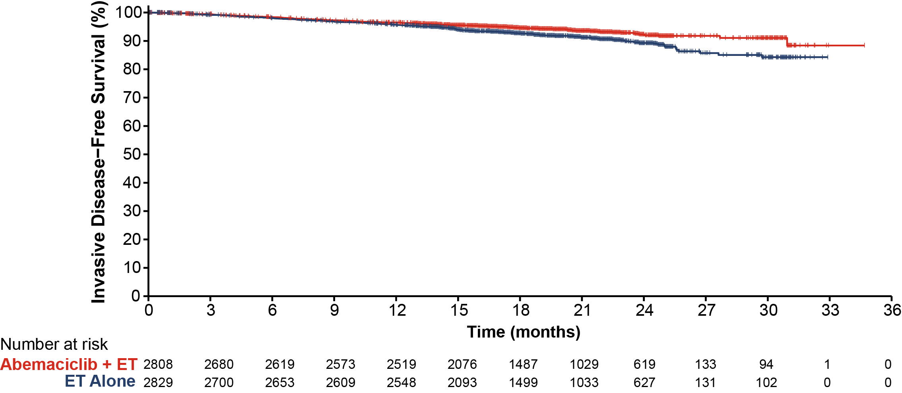
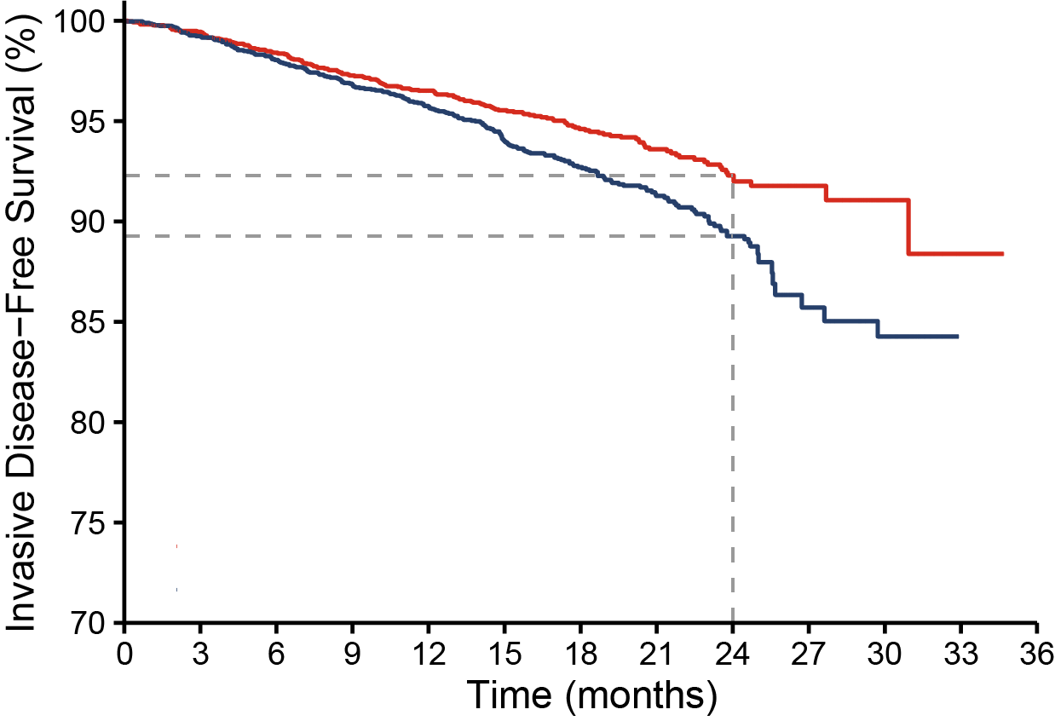
monarchE: IDFS
Statistically significant + clinically relevant improvement in IDFS; greater treatment benefit at PO analysis;
2-year IDFS rates were 92.3% in the abemaciclib + ET arm vs 89.3% in the ET arm: 3.0% difference
Number of IDFS events
Abemaciclib + ET | ET Alone
163 | 232
Nominal P = .0009 (2-sided) HR (95% CI): 0.713 (0.583, 0.871) IA2 HR (95% CI) = 0.747 (0.598, 0.932)
Risk of developing an IDFS event reduced by 28.7%
O’Shaughnessy J, et al. SABCS 2020. Abstract GS1-01.

Slide 16
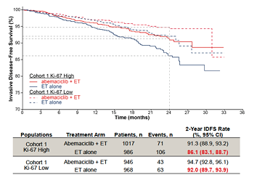
monarchE: High Ki-67 As a Biomarker for High-Risk Early BC
Ki-67: centrally assessed in patients using a standardized kit
Additional endpoints: efficacy in patients with tumors bearing high (≥ 20%; HR, 95% CI: 0.643) or low (< 20%; HR, 95% CI: 0.685) Ki-67 expression
No international consensus for a high Ki-67 cut-off vs low
Threshold ≥ 20% selected based upon historical data + St Gallen guidelines
Among patients with high clinicopathological risk factors, patients with high Ki-67 tumors had a greater risk of recurrence vs patients with low Ki-67 tumors, confirming the prognostic value of Ki-67
Harbeck N, et al. SABCS 2020. Abstract PD2-01.
Notes:
Harbeck N, Johnston S, Fasching P, et al. High Ki-67 as a biomarker for identifying patients with high risk early breast cancer treated in monarchE. Presented at: 2020 San Antonio Breast Cancer Virtual Symposium; December 8-11, 2020; San Antonio, Texas. Abstract PD2-01.

Slide 17
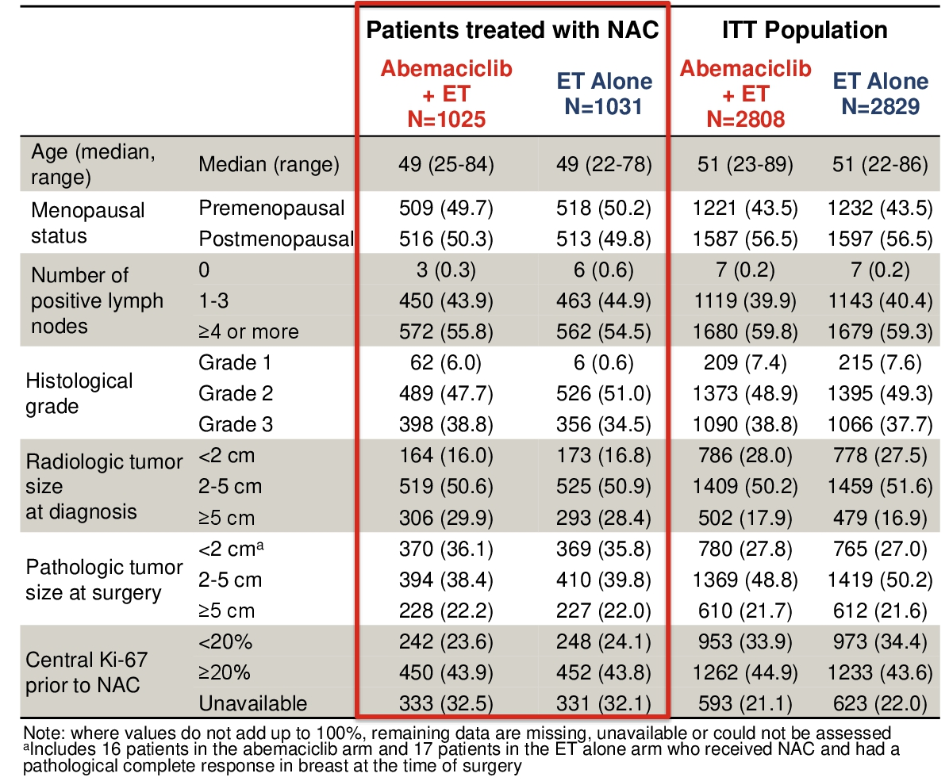
MonarchE: Subgroup of High-Risk Early Breast Cancer Patients Who Received NAC – Disease Characteristics
Several patients had prior chemotherapy, NAC adjuvant or no chemo.
Subgroup of 2056 patients, who received NAC
Exploratory analysis of NAC patients, who path. Tumor sizes > 2 vs ≤ 2 cm at time of surgery
Martin M, et al. Presented at: ASCO Virtual: 2021. Abstract 517.
Notes:
ET = endocrine therapy
ITT = intention-to-treat
NAC = neoadjuvant chemotherapy
Martin M, Hegg R, Kim SB, et al. Abemaciclib combined with adjuvant endocrine therapy in patients with high risk early breast cancer who received neoadjuvant chemotherapy (NAC). Presented at: The American Society of Clinical Oncology (ASCO) 2021 Annual Meeting Virtual; June 4-8, 2021; Abstract 517.

Slide 18
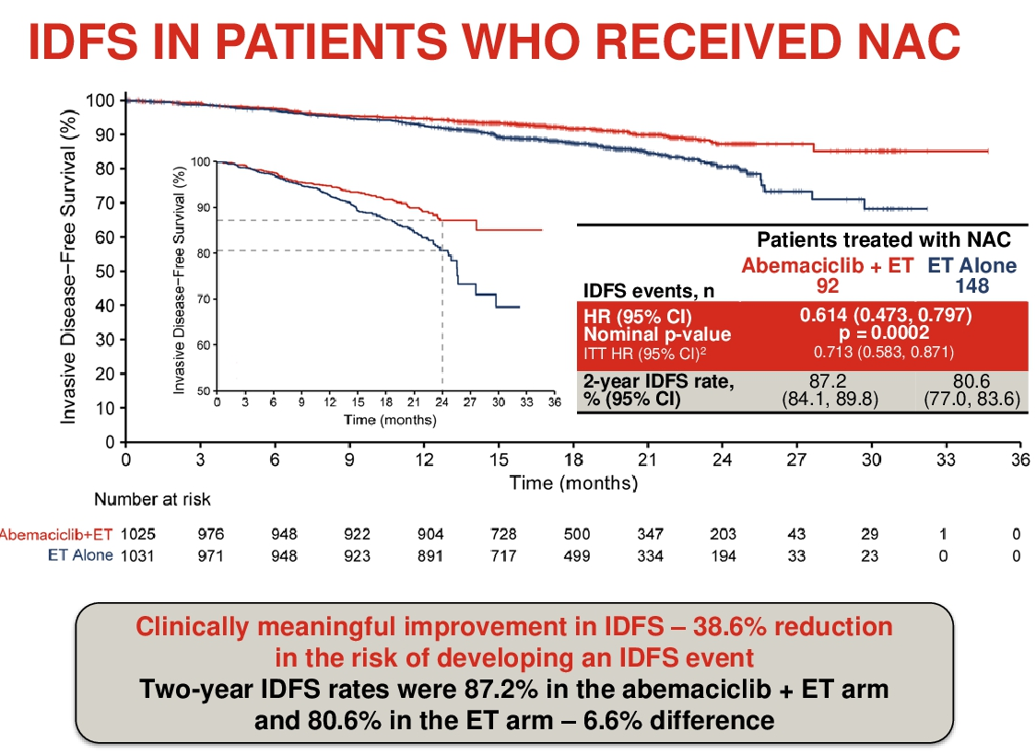
MonarchE: Subgroup of High-Risk Early Breast Cancer Patients Who Received NAC
Abemaciclib + ET demonstrated treatment benefit in terms of IDFS vs ET alone (HR: 0.614 95% CI: 0.473, 0.797) with 2-year IDFS rates of 87.2% vs 80.6%, respectively
The addition of abemaciclib to ET resulted in an improvement in distant relapse-free survival (DRFS) (HR: 0.609, 95% CI: 0.459, 0.809), with 2-year DRFS rates of 89.5% and 82.8%, respectively
Martin M, et al. Presented at: ASCO Virtual: 2021. Abstract 517.
Notes:
ET = endocrine therapy
IDFS = invasive disease-free survival
NAC = neoadjuvant chemotherapy
DRFS = in distant relapse-free survival
Martin M, Hegg R, Kim SB, et al. Abemaciclib combined with adjuvant endocrine therapy in patients with high risk early breast cancer who received neoadjuvant chemotherapy (NAC). Presented at: The American Society of Clinical Oncology (ASCO) 2021 Annual Meeting Virtual; June 4-8, 2021; Abstract 517.

Slide 19
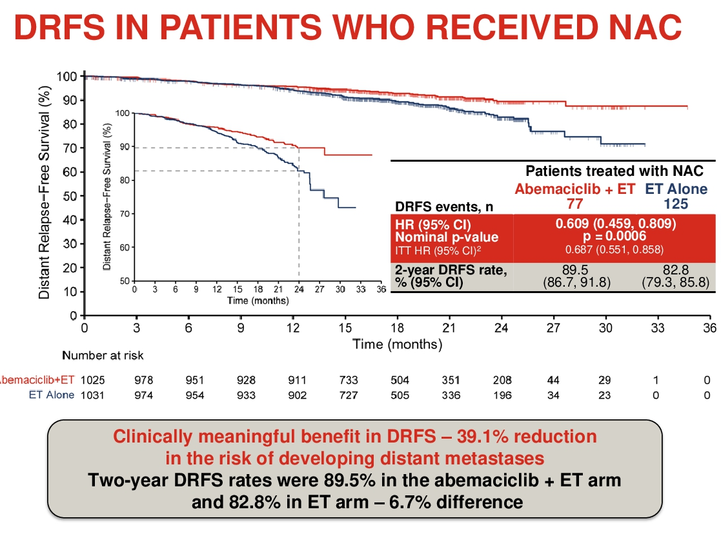
MonarchE: Subgroup of High-Risk Early Breast Cancer Patients Who Received NAC (cont)
The addition of abemaciclib to ET resulted in an improvement in distant relapse-free survival (DRFS) (HR: 0.609, 95% CI: 0.459, 0.809), with 2-year DRFS rates of 89.5% and 82.8%, respectively
Benefit (IDFS and DRFS) independent of tumor size prior or after NAC (≤/> 2 cm)
Martin M, et al. Presented at: ASCO Virtual: 2021. Abstract 517.
Notes:
ET = endocrine therapy
IDFS = invasive disease-free survival
NAC = neoadjuvant chemotherapy
DRFS = in distant relapse-free survival
Martin M, Hegg R, Kim SB, et al. Abemaciclib combined with adjuvant endocrine therapy in patients with high risk early breast cancer who received neoadjuvant chemotherapy (NAC). Presented at: The American Society of Clinical Oncology (ASCO) 2021 Annual Meeting Virtual; June 4-8, 2021; Abstract 517.

Slide 20
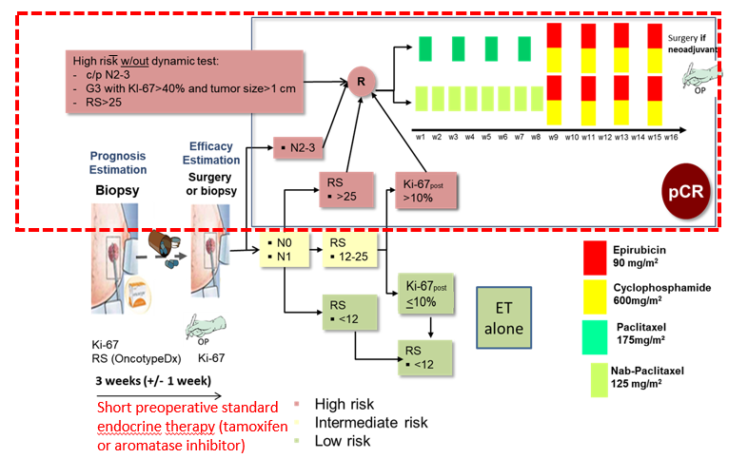
WSG-ADAPT HR+/HER2-: Study Design
Female patients > 18 years
ER and/or PR positive (> 1%)/ HER2-negative unilateral EBC
cT1-4c, cN0-3
Candidates for adjuvant chemotherapy by conventional prognostic criteria: cT2 or G3 or Ki-67 > 15% or < 35 years old or cN+
Trial Design
Gluz O, et al. Presented at: ASCO Virtual; 2021. Abstract 504.
Notes:
DRFS = in distant relapse-free survival
EBC = early breast cander
ET = endocrine therapy
IDFS = invasive disease-free survival
NAC = neoadjuvant chemotherapy
Gluz O, NitzU, Christgen M, et al Prognostic impact of recurrence score (RS) Results, Endocrine Response and Clinical-pathological Factors in High-risk Luminal Early Breast Cancer: Results from the WSG-ADAPT HR+/HER2- Chemotherapy Trial (CT). Presented at: The American Society of Clinical Oncology (ASCO) 2021 Annual Meeting Virtual; June 4-8, 2021; Abstract 504.

Slide 21
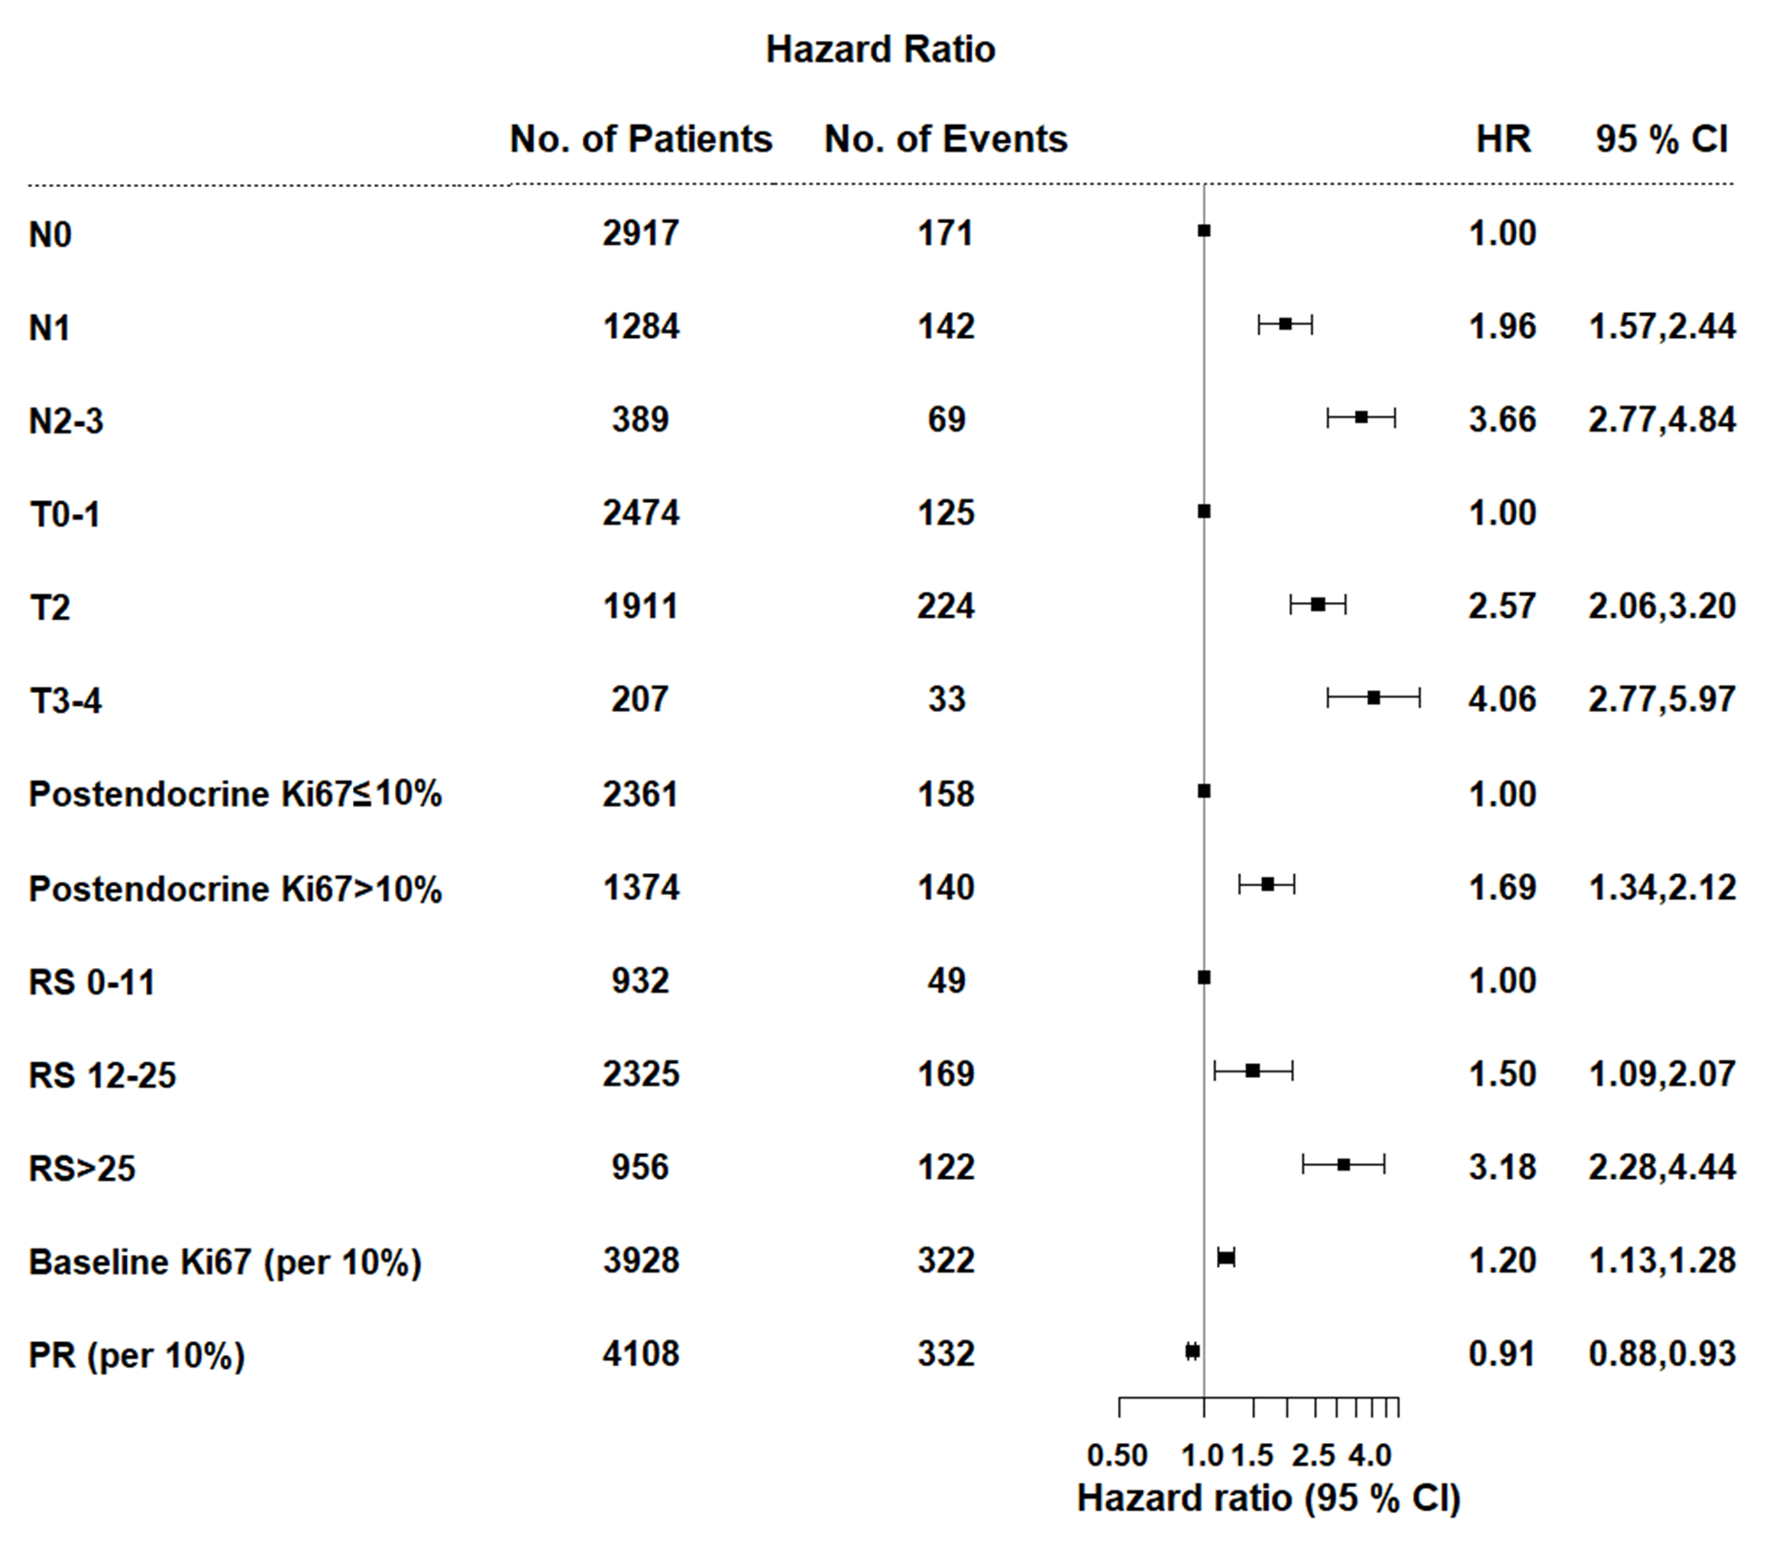
WSG-ADAPT HR+/HER2- Study: Prognostic Markers for iDFS
After 4.9 year median follow-up, higher baseline and postendocrine Ki-67 levels were associated with poorer IDFS (both P < .001)
In the CT cohort (n = 2241), higher RS, nodal status, and tumor size were generally associated with poorer IDFS
In patients with RS > 25 (n = 965), low Ki67_{postendocrine}, N0 status, and c/pT1 status were associated with improved IDFS
ET responders had higher 5-year iDFS (93%) than did ET nonresponders (90%; P_{log-rank}= .040)
Gluz O, et al. Presented at: ASCO Virtual; 2021. Abstract 504.
Notes:
c/p =
DRFS = in distant relapse-free survival
ET = endocrine therapy
IDFS = invasive disease-free survival
RS = recurrence score
Gluz O, Nitz U, Kuemmel S, et al. Prognostic impact of recurrence score, endocrine response and clinical-pathological factors in high-risk luminal breast cancer: Results from the WSG-ADAPT HR+/HER2-chemotherapy trial. Presented at: ASCO 2021 Annual Meeting; June 4-8, 2021. Abstract 504.

Slide 22
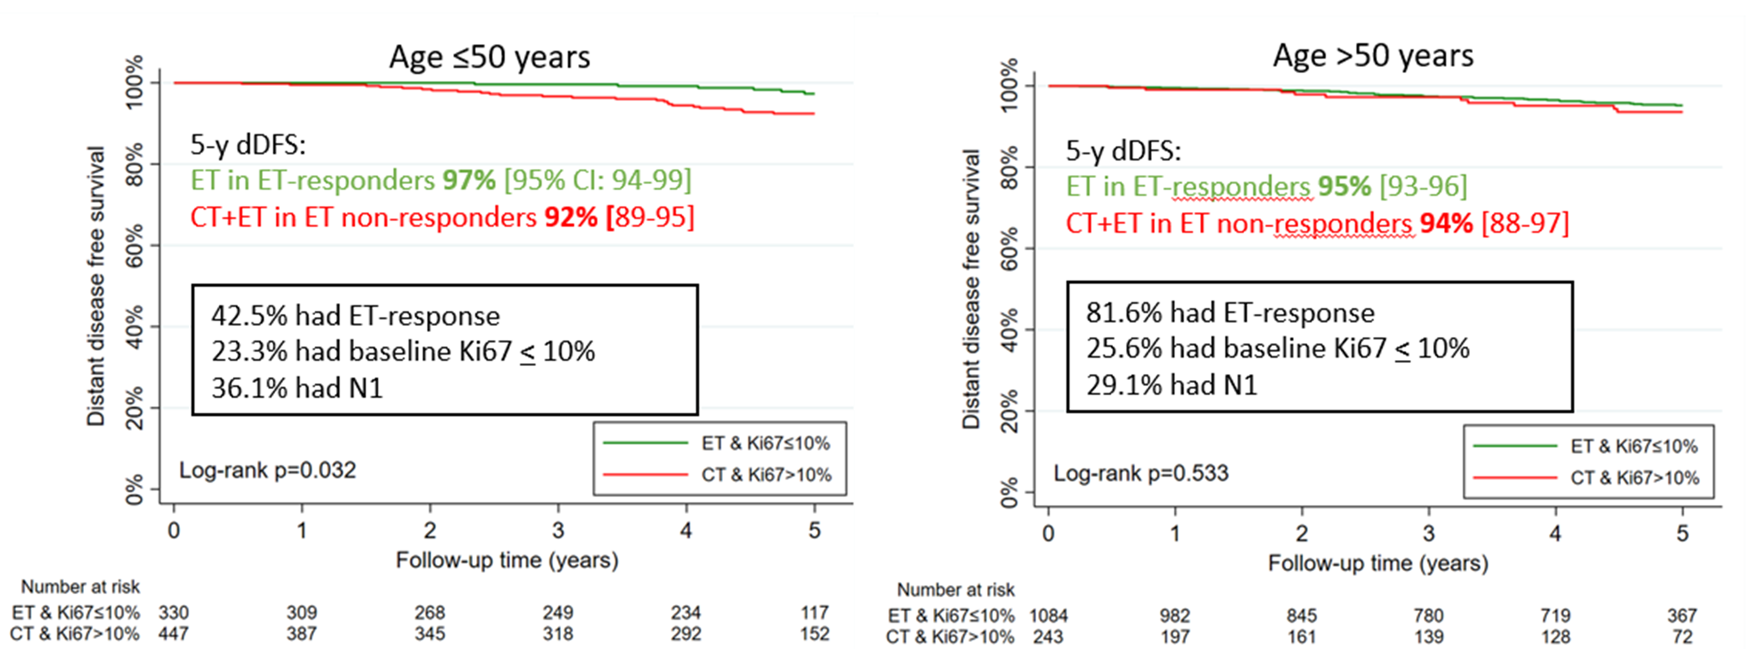
ADAPT HR+/HER2- Study and ET Trial
After 4.9-year median f/u, higher baseline and postendocrine Ki-67 levels were associated with poorer IDFS (both P < .0001)
In the CT cohort (n = 2335), higher RS, nodal status, and tumor size were generally associated with poorer IDFS
In patients with RS > 25 (n = 956), low Ki67_{postendocrine}, N0 status, and c/pT1 status were associated with improved IDFS
ET-responders had higher 5-year IDFS (93%) than ET-non-responders (90%; p_{log-rank}= 0.040)
Gluz O, et al. Presented at: ASCO Virtual; 2021. Abstract 504.
Notes:
IDFS = invasive disease-free survival
References:
Gluz O, NitzU, Christgen M, et al Prognostic impact of recurrence score (RS) Results, Endocrine Response and Clinical-pathological Factors in High-risk Luminal Early Breast Cancer: Results from the WSG-ADAPT HR+/HER2- Chemotherapy Trial (CT). Presented at: The American Society of Clinical Oncology (ASCO) 2021 Annual Meeting Virtual; June 4-8, 2021; Abstract 504.

Slide 23
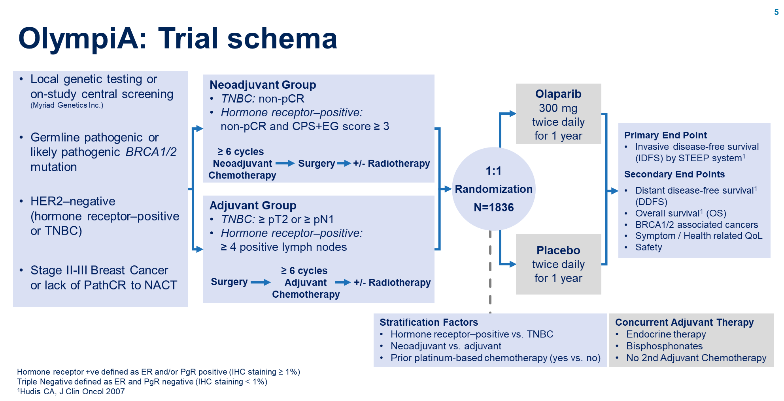
OlympiA: Study Design
Interim analysis triggered by 165 IDFS events from first 900 patients randomized
Assumed true Hazard Ratio IDFS = 0.7
1836 patients were enrolled between 05-June-2014 and 28-May-2019
Median follow-up for ITT population 2.5 years, for mature cohort 3.5 years
Tutt A, et al. Presented at: ASCO Virtual; 2021. Abstract LBA1.
Notes:
ER = estrogen receptor
ET = endocrine therapy
HR =?
DDFS = distant disease-free survival
IDFS = invasive disease-free survival
IHC = immunohistochemistry
ITT = intention-to-treat
PgR = progesterone receptors
OS = overall survival
QoL = quality of life
TNBC = triple negative breast cancer
Tutt A, Garber JE, Kaufman B, et al. OlympiA: A phase III, multicenter, randomized, placebo-controlled trial of adjuvant olaparib after (neo)adjuvant chemotherapy in patients with germline BRCA1/2 mutations and high-risk HER2-negative early breast cancer. Presented at: The American Society of Clinical Oncology (ASCO) 2021 Annual Meeting Virtual; June 4-8, 2021; Abstract LBA1.

Slide 24
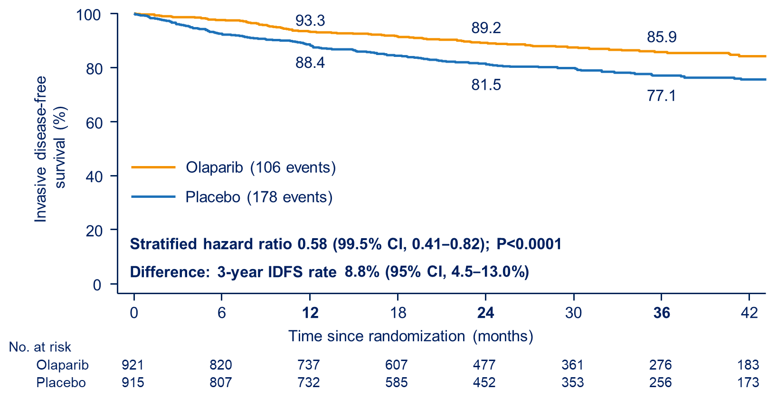
OlympiA: IDFS ITT Analysis
Stratified hazard ratio 0.58 (99.5% CI, 0.41 to 0.82); P < 0.0001
Difference: 3-year IDFS rate 8.8% (95% CI, 4.5% to 13.0%)
Olaparib (106 events) vs placebo (178 events)
Tutt A, et al. Presented at: ASCO Virtual; 2021. Abstract LBA1.
Notes:
R = estrogen receptor
ET = endocrine therapy
HR =?
DDFS = distant disease-free survival
IDFS = invasive disease-free survival
IHC = immunohistochemistry
ITT = intention-to-treat
PgR = progesterone receptors
OS = overall survival
QoL = quality of life
TNBC = triple negative breast cancer
References:
Tutt A, Garber JE, Kaufman B, et al. OlympiA: A phase III, multicenter, randomized, placebo-controlled trial of adjuvant olaparib after (neo)adjuvant chemotherapy in patients with germline BRCA1/2 mutations and high-risk HER2-negative early breast cancer. Presented at: The American Society of Clinical Oncology (ASCO) 2021 Annual Meeting Virtual; June 4-8, 2021; Abstract LBA1.

Slide 25
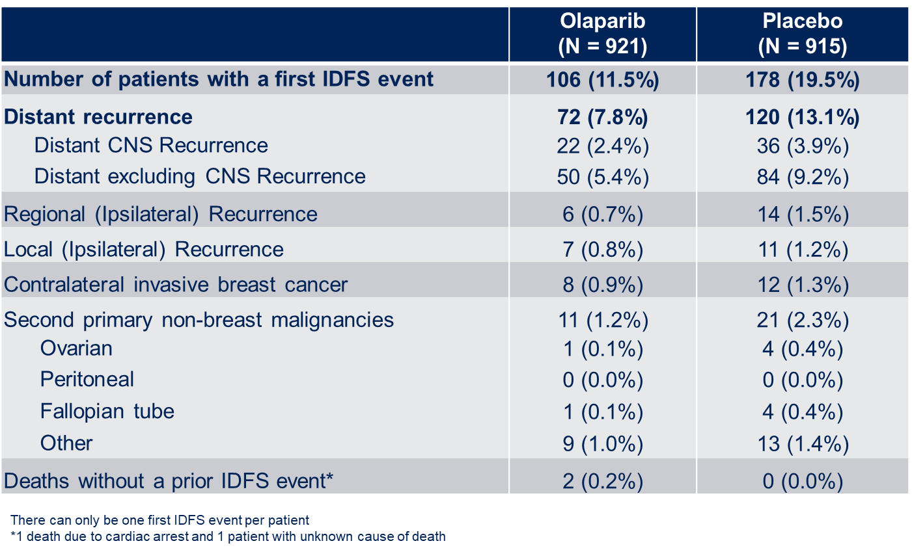
OlympiA: Type of First IDFS Event
Distant recurrence 72 (7.8%) vs 120 (13.1%)
Distant CNS Recurrence 22 (2.4%) vs 36 (3.9%)
Distant excluding CNS Recurrence 50 (5.4%) vs 84 (9.2%)
Regional (Ipsilateral) Recurrence 6 (0.7%) vs 14 (1.5%)
Local (Ipsilateral) Recurrence 7 (0.8%) vs 11 (1.2%)
Tutt A, et al. Presented at: ASCO Virtual; 2021. Abstract LBA1.
Notes:
References:
CNS = central nervous system (?)
ER = estrogen receptor
ET = endocrine therapy
HR =?
DDFS = distant disease-free survival
IDFS = invasive disease-free survival
IHC = immunohistochemistry
ITT = intention-to-treat
PgR = progesterone receptors
OS = overall survival
QoL = quality of life
TNBC = triple negative breast cancer
References:
Tutt A, Garber JE, Kaufman B, et al. OlympiA: A phase III, multicenter, randomized, placebo-controlled trial of adjuvant olaparib after (neo)adjuvant chemotherapy in patients with germline BRCA1/2 mutations and high-risk HER2-negative early breast cancer. Presented at: The American Society of Clinical Oncology (ASCO) 2021 Annual Meeting Virtual; June 4-8, 2021; Abstract LBA1.

Slide 26
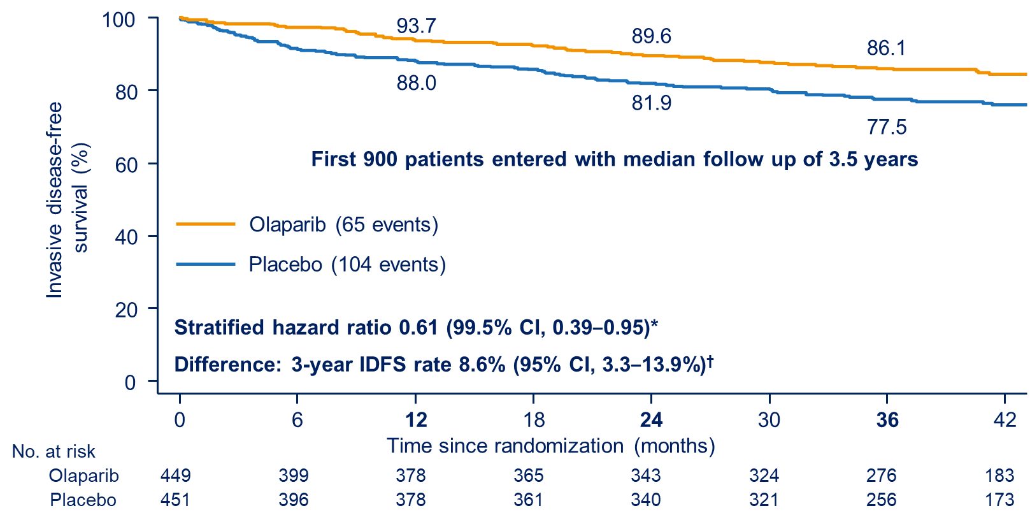
OlympiA: IDFS Analysis Mature Cohort
Tutt A, et al. ASCO 2021. Abstract LBA-01.
Tutt A, et al. Presented at: ASCO Virtual; 2021. Abstract LBA1.
Notes:
References:
CNS = central nervous system (?)
ER = estrogen receptor
ET = endocrine therapy
HR =?
DDFS = distant disease-free survival
IDFS = invasive disease-free survival
IHC = immunohistochemistry
ITT = intention-to-treat
PgR = progesterone receptors
OS = overall survival
QoL = quality of life
TNBC = triple negative breast cancer
References:
Tutt A, Garber JE, Kaufman B, et al. OlympiA: A phase III, multicenter, randomized, placebo-controlled trial of adjuvant olaparib after (neo)adjuvant chemotherapy in patients with germline BRCA1/2 mutations and high-risk HER2-negative early breast cancer. Presented at: The American Society of Clinical Oncology (ASCO) 2021 Annual Meeting Virtual; June 4-8, 2021; Abstract LBA1.

Slide 27
Conclusions ASCO 2021 HR+/HER2- Early Breast Cancer
CDK4/6-Inhibition in Early Breast Cancer
In the MonarchE-Study, abemaciclib combined with standard ET demonstrated a reduction in the risk of developing IDFS and DRFS events for patients with HR+, HER2-, high risk EBC
In patients who received NAC, abemaciclib combined with ET demonstrated a clinically meaningful treatment benefit in IDFS and DRFS
PALLAS and PenelopeB did not demonstrate a benefit in combining ET with palbociclib
Adapt Trial
Combination of lower post-endocrine Ki-67 and limited tumor burden may be a promising criterion for CT de-escalation strategies even in patients with high RS
OlympiA-Study
Participants in OlympiA with HER2-negative early breast cancer and germline BRCA1/2 mutation had significant risk of IDFS and DDFS events despite standard therapies
Fewer deaths were reported on olaparib but overall survival benefit was not significant at median FU of 2.5 months and IA specified P<0.01, further blinded follow-up will be required
Toxicity was limited and manageable without effect on global patient-reported quality of life
Potential to become new standard of care in this patient cohort
Notes:
References:

Slide 28
Advanced Metastatic Breast Cancer

Slide 29
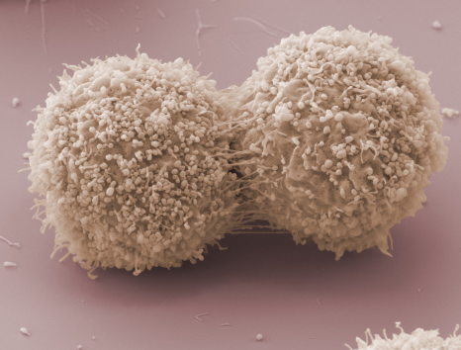
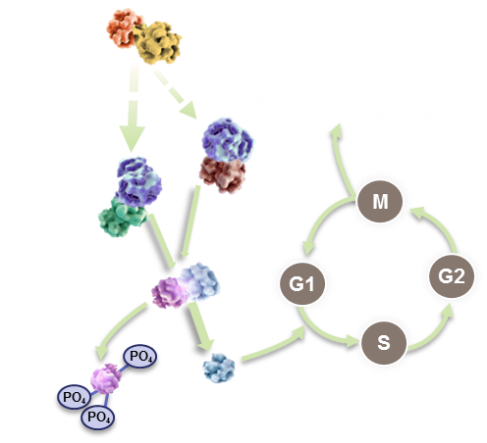
CDK 4/6 Inhibition: Basic Biology

Slide 30
CDK 4/6 Inhibition is Most Effective Against Luminal BC Cell lines
Finn RS, et al. Breast Cancer Res. 2009;11:R77.
Notes:
BC = breast cancer
Finn RS, Dering J, Conklin D, et al. PD 0332991, a selective cyclin D kinase 4/6 inhibitor, preferentially inhibits proliferation of luminal estrogen receptor-positive human breast cancer cell lines in vitro. Breast Cancer Res. 2009;11(5):R77. doi:10.1186/bcr2419

Slide 31
FDA-Approved CDK 4/6 Inhibitors
Palbociclib^{[a]} PD 0332991
Abemaciclib^{[b]}
LY2835219
Ribociclib^{[c]}
LEE011
O
F
N
N
F
HN
N
N
O
N
N
H N
N
N
O
N
N
N
HN
N
N
N
N
N
N
HN
N
N H
CDK 4 IC₅₀ = 11 nM
CDK 6 IC₅₀ = 16 nM
CDK 4 IC = 2 nM
CDK 6 IC = 9.9 nM
CDK 9 IC = 57 nM
CDK 1 IC = 1627 nM
CDK 4 IC₅₀ = 10 nM
CDK 6 IC₅₀ = 39 nM
a. Fry DW, et al. Mol Cancer Ther. 2004;3:1427; b. Gelbert LM, et al. Invest New Drugs. 2014;32:825-837; c. Kim S, et al. Mol Cancer Ther. 2013;12(11 Suppl):PR02.
Notes:
Fry DW, Harvey PJ, Keller PR, et al. Specific inhibition of cyclin-dependent kinase 4/6 by PD 0332991 and associated antitumor activity in human tumor xenografts. Mol Cancer Ther. 2004;3:1427-1438. PMID: 15542782.
Gelbert LM, Cai S, Lin X, et al. Preclinical characterization of the CDK4/6 inhibitor LY2835219: in-vivo cell cycle-dependent/independent anti-tumor activities alone/in combination with gemcitabine. Invest New Drugs. 2014;32:825-837. doi: 10.1007/s10637-014-0120-7. Epub 2014 Jun 13. PMID: 24919854; PMCID: PMC4169866.
Kim S, Loo A, Chopra R, Caponigro G, et al. Abstract PR02: LEE011: An orally bioavailable, selective small molecule inhibitor of CDK4/6– Reactivating Rb in cancer. Mol Cancer Ther 2013;12(11 Suppl):PR02.

Slide 32
Study Population and Results for Pivotal CDK 4/6 Inhibitor Trials
Trial | CDK Inhibitor | Line of Therapy (Endocrine Rx) | Menopausal Status | PFS Hazard Ratio | Statistical Significance | OS Hazard Ratio | Statistical Significance
PALOMA-2^{[a]} | Palbociclib^{[k]} | 1L AI | Post | 0.56 | Yes | NR | NR
MONALEESA-2^{[b]} | Ribociclib^{[l]} | 1L AI | Post | 0.57 | Yes | NR | NR
MONALEESA-7^{[c,d]*} | Ribociclib^{[l]} | 1L AI or Tam | Pre/Peri | 0.55 | Yes | 0.70 | Yes
MONARCH-3^{[e]} | Abemaciclib^{[m]} | 1L AI | Post | 0.54 | Yes | NR | NR
PALOMA-3^{[f,g]} | Palbociclib^{[k]} | 2L Fulv | Pre/Post | 0.46 | Yes | 0.81 | No
MONALEESA-3^{[h]} | Ribociclib^{[l]} | 1L/2L Fulv | Pre/Post | 0.59 | Yes | 0.72 | Yes
MONARCH-2^{[i,j]} | Abemaciclib^{[m]} | 2L Fulv | Pre/Post | 0.55 | Yes | 0.76 | Yes
*PFS/OS data reported for approved AI subset.
a. Rugo HS, et al. Breast Cancer Res Treat. 2019;174:719-729; b. Hortobagyi GN, et al. Ann Oncol. 2018;29:1541-1547; c. Tripathy D, et al. Lancet Oncol. 2018;19:904-915; d. Im SA, et al. N Engl J Med. 2019;381:307-316; e. Goetz MP, et al. J Clin Oncol. 2017;35:3638-3646;f. Cristofanilli M, et al. Lancet Oncol. 2016;17:425-439; g. Turner NC, et al. N Engl J Med. 2018;379:1926-1936; h. Slamon DJ, et al. N Engl J Med. 2020;382:514-524 i. Sledge G, et al. J Clin Oncol. 2017;35:2875-2884; j. Sledge GW, et al. JAMA Oncol. 2019;6:116-124; k. IBRANCE® (palbociclib) [PI]. 2019; l. KISQALI® (ribociclib) [PI]. 2017; m. Verzenio® (abemaciclib) [PI]. 2017.
Notes:
Rugo HS, Finn RS, Diéras V, et al. Palbociclib plus letrozole as first-line therapy in estrogen receptor-positive/human epidermal growth factor receptor 2-negative advanced breast cancer with extended follow-up. Breast Cancer Res Treat. 2019;174:719-729.
Hortobagyi GN, Stemmer SM, Burris HA, et al. Updated results from MONALEESA-2, a phase III trial of first-line ribociclib plus letrozole versus placebo plus letrozole in hormone receptor-positive, HER2-negative advanced breast cancer. Ann Oncol. 2018;29:1541-1547.
c. Tripathy D, Im SA, Colleoni M, Franke F, et al. Ribociclib plus endocrine therapy for premenopausal women with hormone-receptor-positive, advanced breast cancer (MONALEESA-7): a randomised phase 3 trial. Lancet Oncol. 2018;19:904-915.
d. Im SA, Lu YS, Bardia A, et al. Overall Survival with Ribociclib plus Endocrine Therapy in Breast Cancer. N Engl J Med. 2019;381:307-316.
e. Goetz MP, Toi M, Campone M, et al. MONARCH 3: Abemaciclib As Initial Therapy for Advanced Breast Cancer. J Clin Oncol. 2017;35:3638-3646.
f. Cristofanilli M, Turner NC, Bondarenko I, et al. Fulvestrant plus palbociclib versus fulvestrant plus placebo for treatment of hormone-receptor-positive, HER2-negative metastatic breast cancer that progressed on previous endocrine therapy (PALOMA-3): final analysis of the multicentre, double-blind, phase 3 randomised controlled trial. Lancet Oncol. 2016;17:425-439.
g. Turner NC, Slamon DJ, Ro J, et al. Overall Survival with Palbociclib and Fulvestrant in Advanced Breast Cancer. N Engl J Med. 2018 Nov 15;379(20):1926-1936.
H. Slamon DJ, Neven P, Chia S, et al. Overall Survival with Ribociclib plus Fulvestrant in Advanced Breast Cancer. N Engl J Med. 2020;382:514-524.
i. Sledge GW Jr, Toi M, Neven P, et al. MONARCH 2: Abemaciclib in Combination With Fulvestrant in Women With HR+/HER2- Advanced Breast Cancer Who Had Progressed While Receiving Endocrine Therapy. J Clin Oncol. 2017;35(25):2875-2884.
i. Sledge GW Jr, Toi M, Neven P, et al. The Effect of Abemaciclib Plus Fulvestrant on Overall Survival in Hormone Receptor-Positive, ERBB2-Negative Breast Cancer That Progressed on Endocrine Therapy-MONARCH 2: A Randomized Clinical Trial. JAMA Oncol. 2019;6:116–124.
k. IBRANCE® (pablociclib) [prescribing information]. Pfizer, Inc. Approved 2015. Revised April 2019.
l. KISQALI® (ribociclib) [prescribing information]. Novartis Pharmaceuticals Corp. Approved 2017. Revised March 2017.
m. Verzenio® (abemaciclib) [prescribing information]. Eli Lilly and Company. Approved 2017. Revised September 2017.
CDK = cyclin-dependent kinase
PFS=progression-free survival
OS=overall survival
AI=aromatase inhibitor
Fulv=fulvestrant
NR=not reported

Slide 33
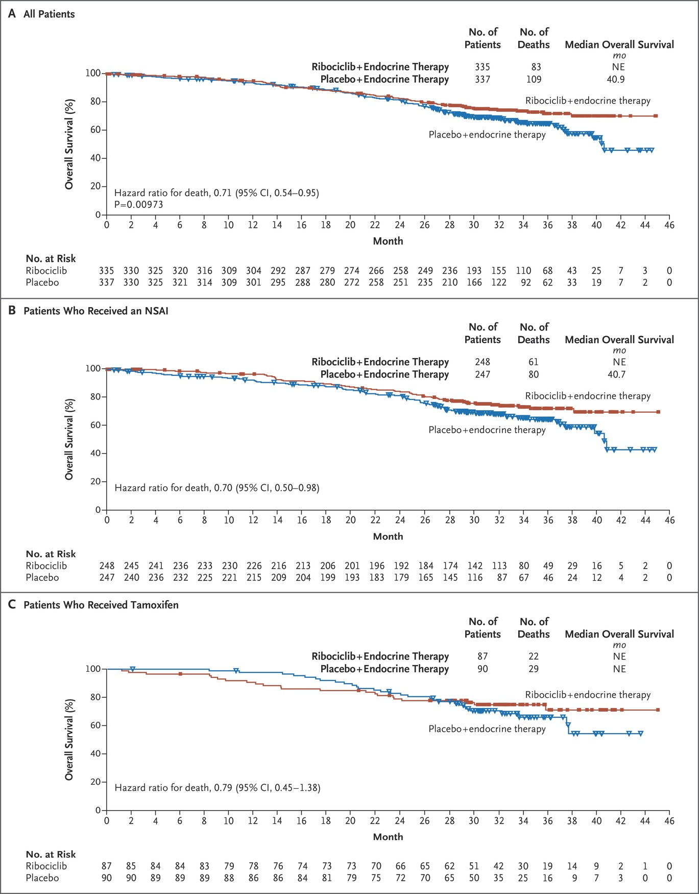
MONALEESA-7: Overall Survival Advantage in Premenopausal Women for Ribociclib
Hurvitz S, et al. ASCO 2019. Abstract LBA1008.
Notes:
Hurvitz S, IM SA, Lu YS, et al. Phase III MONALEESA-7 trial of premenopausal patients with HR+/HER2- advanced breast cancer treated with endocrine therapy with and without ribociclib: Overall survival results. Presented at: ASCO 2019 Annual Meeting; May 31-June 4; Chicago, IL. Abstract LBA1008.

Slide 34
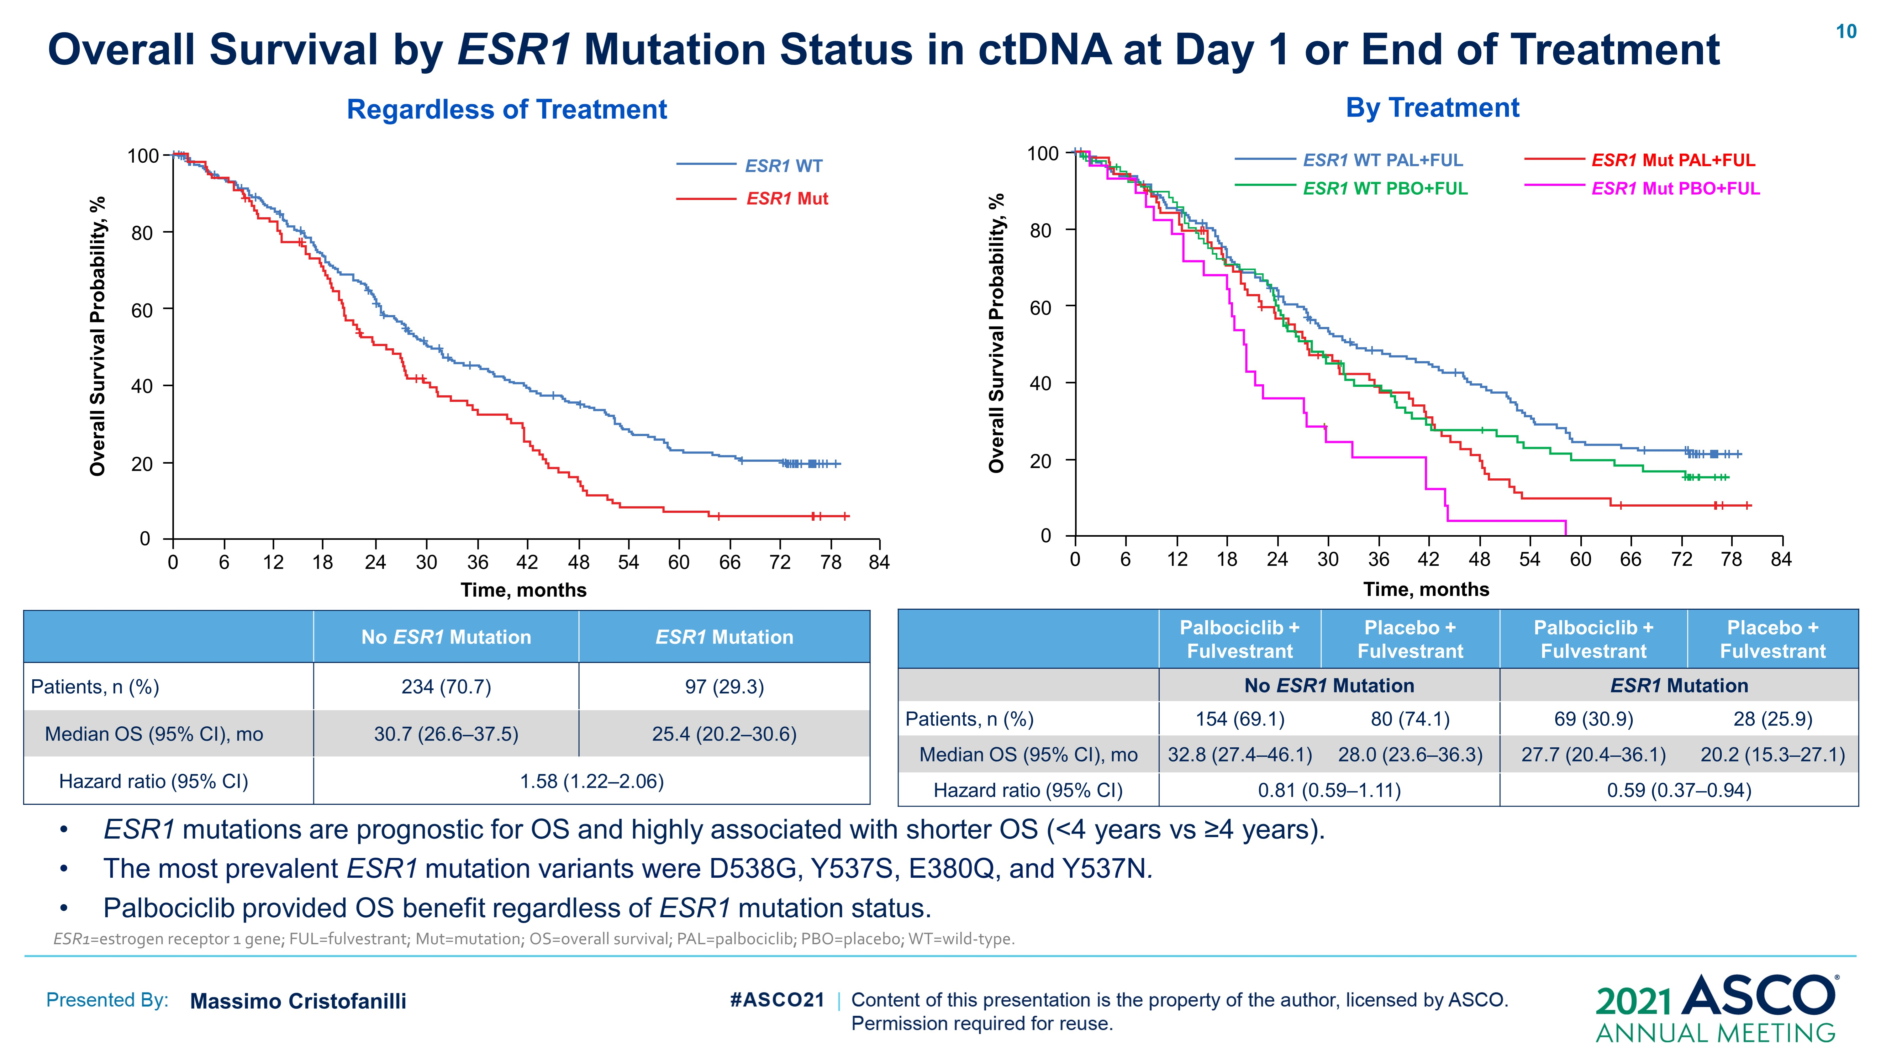
PALOMA-3: Overall Survival by ESR1 Mutation Status in ctDNA at Day 1 or End of Treatment
Regardless of Treatment
By Treatment
ESR1 mutations highly associated with shorter OS (< 4 years vs ≥ years)
Most prevalent ESR1 mutation variants were D538G, Y537S, E380Q, and Y537N
Palbociclib provided OS benefit regardless of ESR1 mutation status
Cristofanilli M, et al. Presented at: ASCO Virtual; 2021. Abstract 1000.
Notes:
ctDNA = circulating tumor DNA
ESR1=estrogen receptor 1 gene
FUL=fulvestrant
Mut=mutation
OS=overall survival
PAL=palbociclib
PBO=placebo
WT=wild-type
Cristofanilli M, et al. Presented at: ASCO Virtual; 2021. Abstract 1000.
Cristofanilli M, Rugo SH, Im SA, et al. Overall Survival With Palbociclib + Fulvestrant in Women With Hormone Receptor-Positive, Human Epidermal Growth Factor Receptor 2-Negative Advanced Breast Cancer: Updated Analyses From PALOMA-3. Presented at: The American Society of Clinical Oncology (ASCO) 2021 Annual Meeting Virtual; June 4-8, 2021; Abstract 1000.

Slide 35
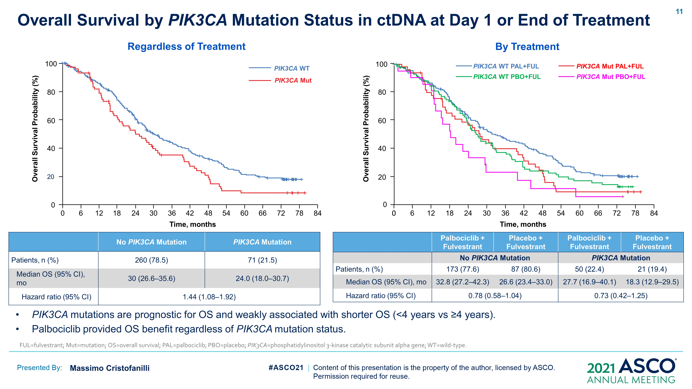
PALOMA-3: Overall Survival by PIK3CA Mutation Status in ctDNA at Day 1 or End of Treatment
Regardless of Treatment
By Treatment
PIK3CA mutations weakly associated with shorter OS (< 4 years vs ≥ 4 years)
Palbociclib provided OS benefit regardless of PIK3CA mutation status
Cristofanilli M, et al. Presented at: ASCO Virtual; 2021. Abstract 1000.
Notes:
ctDNA = circulating tumor DNA
FUL = fulvestrant;
Mut = mutation;
PIK3CA = phosphatidylinositol 3-kinase catalytic subunit alpha gene;
WT = wild-type.
Cristofanilli M, et al. Presented at: ASCO Virtual; 2021. Abstract 1000.
Cristofanilli M, Rugo SH, Im SA, et al. Overall Survival With Palbociclib + Fulvestrant in Women With Hormone Receptor-Positive, Human Epidermal Growth Factor Receptor 2-Negative Advanced Breast Cancer: Updated Analyses From PALOMA-3. Presented at: The American Society of Clinical Oncology (ASCO) 2021 Annual Meeting Virtual; June 4-8, 2021; Abstract 1000.

Slide 36
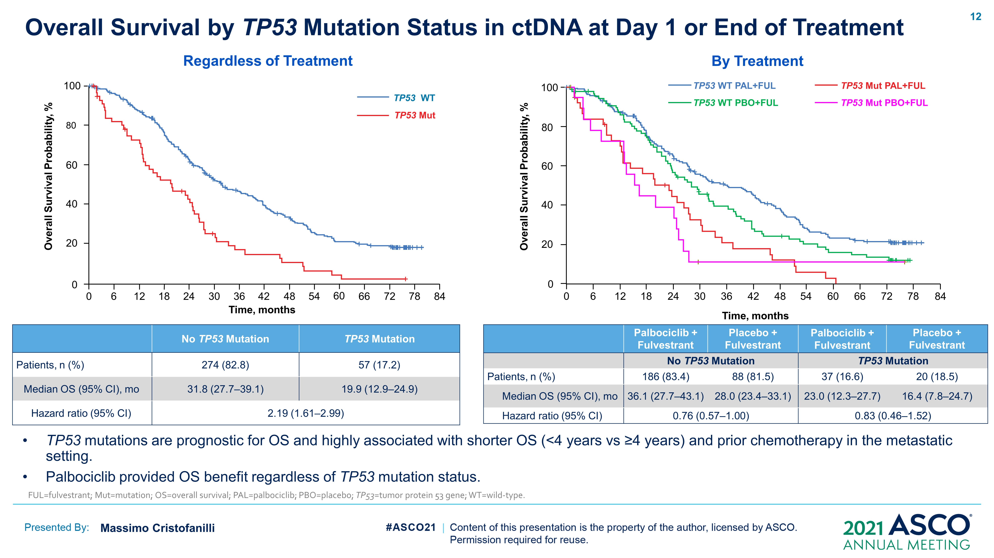
PALOMA-3: Overall Survival by TP53 Mutation Status in ctDNA at Day 1 or End of Treatment
Regardless of Treatment
By Treatment
TP53 mutations highly associated with shorter OS (< 4 years vs ≥ 4 years) and prior chemotherapy in the metastatic setting.
Palbociclib provided OS benefit regardless of TP53 mutation status.
Cristofanilli M, et al. Presented at: ASCO Virtual; 2021. Abstract 1000.
Notes:
ctDNA = circulating tumor DNA
ESR1=estrogen receptor 1 gene
FUL=fulvestrant
Mut=mutation
OS=overall survival
PAL=palbociclib
PBO=placebo
TP53 = tumor protein 53 gene
WT=wild-type
Cristofanilli M, et al. Presented at: ASCO Virtual; 2021. Abstract 1000.
Cristofanilli M, Rugo SH, Im SA, et al. Overall Survival With Palbociclib + Fulvestrant in Women With Hormone Receptor-Positive, Human Epidermal Growth Factor Receptor 2-Negative Advanced Breast Cancer: Updated Analyses From PALOMA-3. Presented at: The American Society of Clinical Oncology (ASCO) 2021 Annual Meeting Virtual; June 4-8, 2021; Abstract 1000.

Slide 37
MONALEESA: Combined Analysis Intrinsic Subtype Affects CDK 4/6 Inhibitor Activity
PFS Analysis by Subtype
Prat A, et al. J Clin Oncol. 2021;39:1458-1467.
Notes:
Prat A, Chaudhury A, Solovieff N, et al. Correlative Biomarker Analysis of Intrinsic Subtypes and Efficacy Across the MONALEESA Phase III Studies. J Clin Oncol. 2021;39:1458-1467. doi: 10.1200/JCO.2
Purchase link:
https://articleworks.cadmus.com/buy?c=1608355&url_back=http://ascopubs.org/doi/abs/10.1200/JCO.20.02977&url=http://ascopubs.org/doi/pdf/10.1200/JCO.20.02977&journal=jco&volume=39&issue_number=13&cover_date=May%201,%202021&startpage=1458&pages=11&title=Correlative%20Biomarker%20Analysis%20of%20Intrinsic%20Subtypes%20and%20Efficacy%20Across%20the%20MONALEESA%20Phase%20III%20Studies&authors=

Slide 38
DAWNA-1: Dalpiciclib the New Kid on the Block
Dalpiciclib is a novel CDK 4/6 inhibitor
Tested in the metastatic setting in a multicenter RCT in combination with FULV (the DAWNA trial)
Patients had HR-positive/HER2-negative locally advanced or metastatic BC who had relapsed or progressed on previous ET
Patients randomized 2:1 to FULV + PLA vs FULV + DALP 150 mg po once daily, days 1 to 21
Primary endpoint of PFS; superiority boundary was 1-sided P = .008 (Lan-DeMets [O’Brien-Fleming] boundary)
Binghe X, et al. ASCO 2021. Abs 1002.
Notes:
Binghe X, Zhang Q, Zhang P, et al. Dalpiciclib versus placebo plus fulvestrant in HR+/HER2- advanced breast cancer thatrelapsed or progressed on previous endocrine therapy (DAWNA-1): A multicenter,randomized, phase 3 study. Presented at: ASCO 2021 Annual Meeting; June 4-8, 2021. Abstract 1002.

Slide 39
DAWNA-1: Dalpiciclib Results
361 patients randomized with 10.5-mo median f/u
PFS: 15.7 mo for DALP vs 7.2 mo for placebo; hazard ratio, 0.42 [95% CI: 0.31, 0.58]; P < .0001
Most common toxicity = grade 3/4 neutropenia
Immature for OS
Binghe X, et al. ASCO 2021. Abs 1002.

Slide 40
PALOMA-3, MONALEESA-3, and MONARCH 2: Patient Populations
 | PALOMA-3^{[a]} N = 521 |  | MONALEESA-3^{[b]} N = 726 |  | MONARCH 2^{[c]} N = 669
 | Fulvestrant + palbociclib | FULV | FULV + ribociclib | FULV + placebo | FULV + abemaciclib | FULV + placebo
ET inclusion criteria | Progressed on or ≤ 12 mo from prior adjuvant therapy with AI*/tamoxifen Progressed on or ≤ 1 mo from prior ABC with AI/ET |  | 1L (treatment naive for ABC) 2L + early relapsers |  | Relapsed on neoadjuvant or on/within 1 y of adjuvant ET Progressed on 1L ET
Age, median (range), y | 57 (30-88) | 56 (29-80) | 63 (31-89) | 63 (34-86) | 59 (32-91) | 62 (32-87)
Most recent ET, No. (%) De novo† (Neo)adjuvant setting ABC setting | – 74 (21%) 273 (79%) | – 40 (23%) 133 (76%) | 97 (20%) 289 (59.7%) 110 (22.7%) | 42 (17.4%) 142 (58.7%) 40 (16.5%) | – 263 (59.0%) 171 (38.3%) | – 133 (59.6%) 85 (38.1%)
Prior chemotherapy | 34% received 1 prior line of chemotherapy for ABC |  | No prior chemotherapy allowed in the advanced setting |  | No prior chemotherapy allowed in the advanced setting
Postmenopausal at study entry, No. (%) | 275 (79.3%) | 138 (79.3%) | 484 (100%) | 242 (100%) | 371 (83.2%) | 180 (80.7)
Visceral metastasis, No. (%) | 206 (59.4%) | 105 (60.3%) | 293 (60.5%) | 146 (60.3%) | 245 (54.9%) | 128 (57.4%)
Adapted from Stephen Johnston. a. Cristofanilli M, et al. Lancet Oncol. 2016;17:425-439; b. Slamon D, et al. J Clin Oncol. 2018;36:2465-2472; c. Sledge GW, et al. J Clin Oncol. 2017;35:2875-2884.
Notes:
Cristofanilli M, Turner NC, Bondarenko I, et al. Fulvestrant plus palbociclib versus fulvestrant plus placebo for treatment of hormone-receptor-positive, HER2-negative metastatic breast cancer that progressed on previous endocrine therapy (PALOMA-3): final analysis of the multicentre, double-blind, phase 3 randomised controlled trial. Lancet Oncol. 2016;17:425-439. doi: 10.1016/S1470-2045(15)00613-0. Epub 2016 Mar 3. Erratum in: Lancet Oncol. 2016 Apr;17 (4):e136. Erratum in: Lancet Oncol. 2016 Jul;17 (7):e270. PMID: 26947331.
Slamon DJ, Neven P, Chia S, et al. Phase III Randomized Study of Ribociclib and Fulvestrant in Hormone Receptor-Positive, Human Epidermal Growth Factor Receptor 2-Negative Advanced Breast Cancer: MONALEESA-3. J Clin Oncol. 2018;36:2465-2472. doi: 10.1200/JCO.2018.78.9909. Epub 2018 Jun 3. PMID: 29860922.
Sledge GW Jr, Toi M, Neven P, et al. MONARCH 2: Abemaciclib in Combination With Fulvestrant in Women With HR+/HER2- Advanced Breast Cancer Who Had Progressed While Receiving Endocrine Therapy. J Clin Oncol. 2017;35:2875-2884. doi: 10.1200/JCO.2017.73.7585. Epub 2017 Jun 3. PMID: 28580882.

Slide 41
Updated Overall Survival Analysis of PALOMA-3
Median Follow-up, 73.3 Months
100
Palbociclib + Fulvestrant (n=347)
Median OS=34.8 months
95% CI, 28.8–39.9
80
Placebo + Fulvestrant (n=174)
Median OS=28.0 months
95% CI, 23.5–33.8
60
Overall Survival Probability, %
40
Stratified HR=0.81
95% CI, 0.65–0.99
Nominal 1-sided P=0.0221
20
Unstratified HR=0.79
95% CI, 0.64–0.97
Nominal 1-sided P=0.0122
0
0
6
12
18
24
30
36
42
48
54
60
66
72
78
Number of patients at risk
Time, months
PAL+FUL
347
322
288
250
211
167
149
128
109
84
68
60
54
4
PBO+FUL
174
156
138
117
89
71
58
43
33
27
22
19
17
0
Median OS was 34.8 months in the palbociclib arm vs 28.0 months in the placebo arm.
5-year OS rate (95% CI): 23.3% (18.7–28.2) in the palbociclib arm; 16.8% (11.2–23.3) in the placebo arm.
Cristofanilli M, et al. Presented at: ASCO Virtual; 2021. Abstract 1000.

Slide 42
Updated Overall Survival by Subgroup
ITT and Subgroups
PAL+FUL
Events/n (%)
PBO+FUL
Events/n (%)
Hazard Ratio
(95% CI)
All randomized patients (ITT, stratified)
All randomized patients (ITT, unstratified)
Sensitivity to previous hormonal therapy
Yes
No
Prior chemotherapy
Neoadjuvant or adjuvant
Advanced/metastatic setting
None
Site of metastatic disease
Visceral
Nonvisceral
Menopausal status at study entry
Pre/peri
Post
ECOG Performance Status
0
1
Disease-free interval
≤24 months
>24 months
Prior lines of therapy in metastatic setting
0
1
2
≥3
258/347 (74.4)
258/347 (74.4)
202/274 (73.7)
56/73 (76.7)
100/140 (71.4)
94/113 (83.2)
64/94 (68.1)
166/206 (80.6)
92/141 (65.2)
53/72 (73.6)
205/275 (74.5)
144/206 (69.9)
114/141 (80.9)
33/40 (82.5)
138/191 (72.3)
50/74 (67.6)
104/141 (73.8)
74/94 (78.7)
30/38 (78.9)
135/174 (77.6)
135/174 (77.6)
104/136 (76.5)
31/38 (81.6)
52/74 (70.3)
53/64 (82.8)
30/36 (83.3)
81/105 (77.1)
54/69 (78.3)
24/36 (66.7)
111/138 (80.4)
86/115 (74.8)
49/59 (83.1)
19/22 (86.4)
77/101 (76.2)
32/40 (80.0)
63/84 (75.0)
30/37 (81.1)
10/13 (76.9)
0.81 (0.65–0.99)
0.79 (0.64–0.97)
0.76 (0.60–0.96)
0.97 (0.62–1.50)
0.84 (0.60–1.17)
0.97 (0.69–1.36)
0.57 (0.37–0.88)
0.90 (0.69–1.18)
0.63 (0.45–0.89)
0.97 (0.60–1.57)
0.74 (0.59–0.94)
0.79 (0.61–1.04)
0.70 (0.50–0.98)
1.3 (0.72–2.26)
0.75 (0.57–0.99)
0.66 (0.43–1.04)
0.84 (0.61–1.14)
0.80 (0.52–1.23)
0.62 (0.29–1.29)
0.0
0.5
1.0
1.5
2.0
2.5
In favor of PAL+FUL
In favor of PBO+FUL
Cristofanilli M, et al. Presented at: ASCO Virtual; 2021. Abstract 1000.

Slide 43
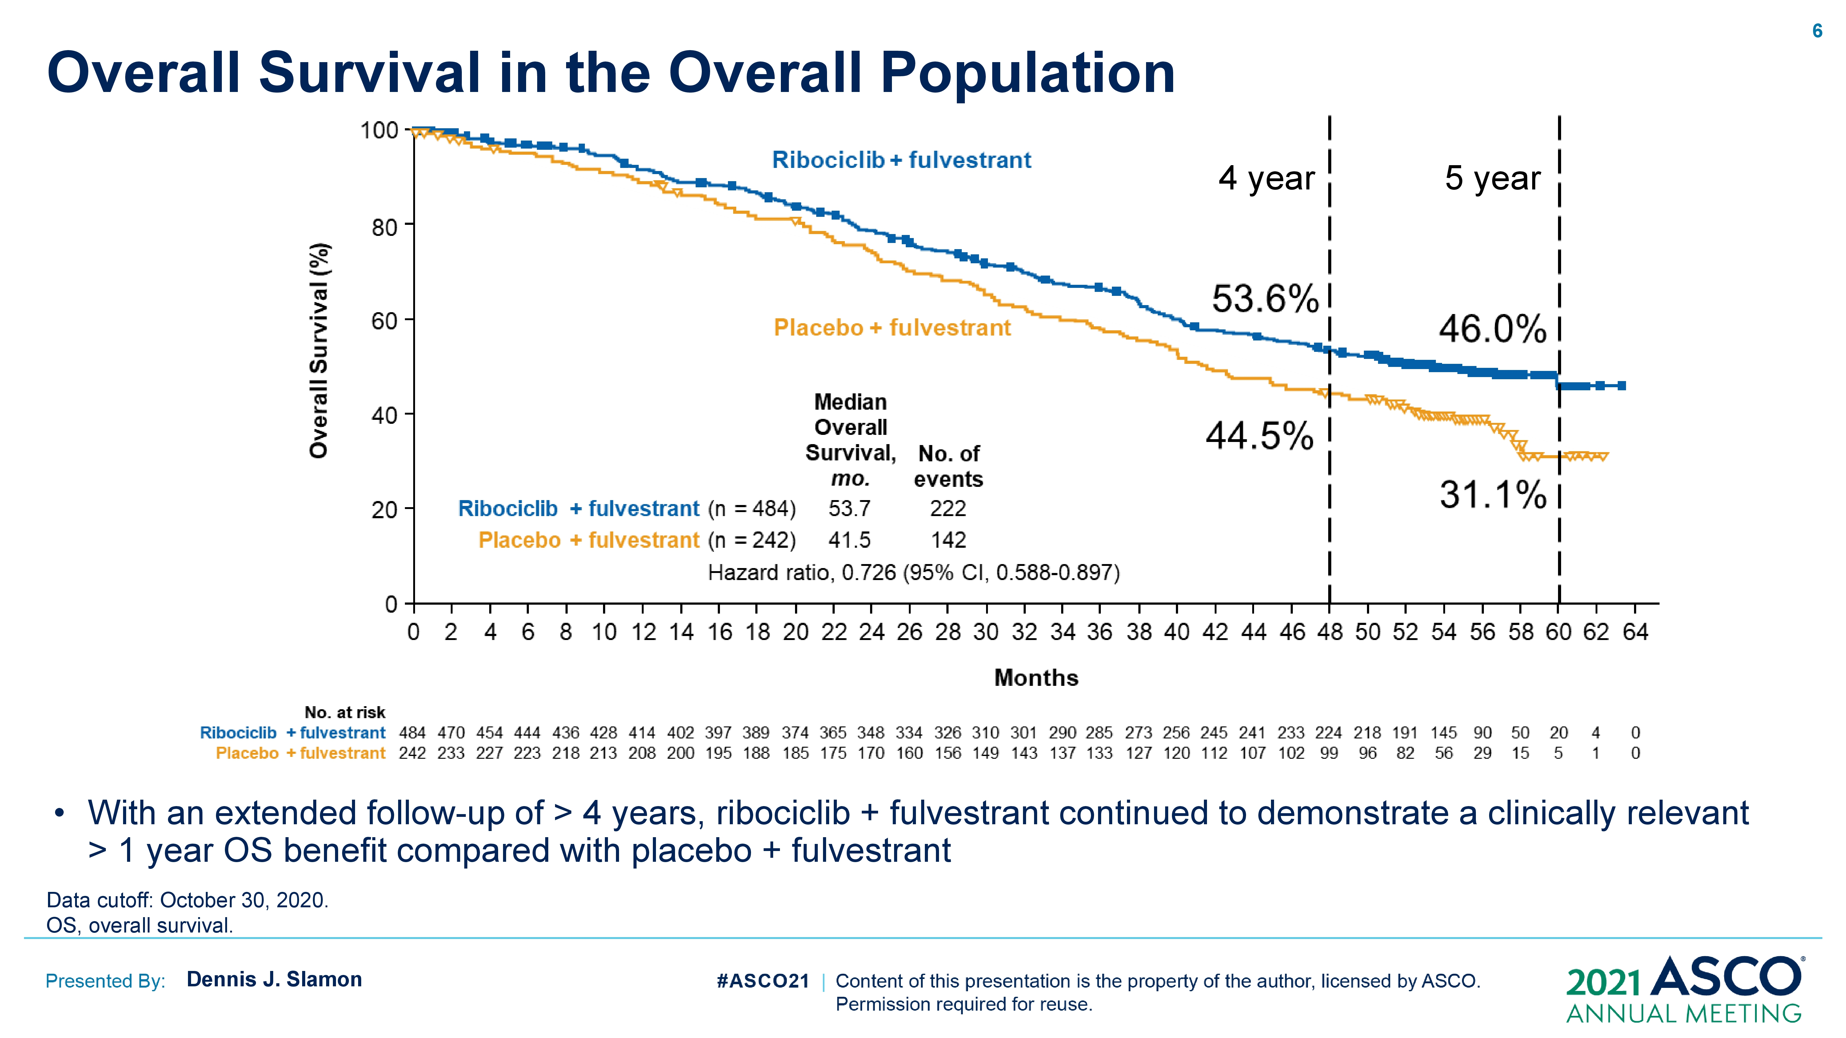
MONALEESA-3: Updated Overall Survival Results
Updated at the 56.3-mo nth median f/u, RIB + FULV remains superior to placebo + FULV (median, 53.7 vs 41.5 months; HR, 0.73; 95% CI, 0.59, 0.90)
RIB + FUL had prolonged OS vs placebo + FUL in the first-line (median, not reached vs 51.8 months; HR, 0.64; 95% CI, 0.46, 0.88) and Second-line subgroups (median, 39.7 vs 33.7 months; HR, 0.78; 95% CI, 0.59, 1.04)
Slamon DJ, et al. Presented at: ASCO Virtual; 2021. Abstract 1001.
Notes:
FUL = fulvestrant
RIB = ribociclib
OS = overall survival
Slamon DJ, et al. Presented at: ASCO Virtual; 2021. Abstract 1001.
Slamon DJ, Neven P, Chia SKL, et al. Updated overall survival (OS) results from the phase III MONALEESA-3 trial of postmenopausal patients (pts) with HR+/HER2- advanced breast cancer (ABC) treated with fulvestrant (FUL) ± ribociclib (RIB). Presented at: The American Society of Clinical Oncology (ASCO) 2021 Annual Meeting Virtual; June 4-8, 2021; Abstract 1001.

Slide 44
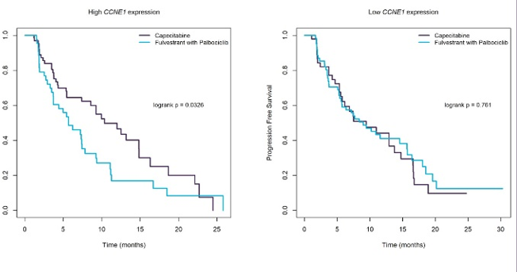
PEARL: CDK 4/6 Inhibitor Resistance
High tumor CCNE1 mRNA expression identifies patients with relative resistance to palbociclib plus fulvestrant in the PEARL study.
Pascual J, et al. Presented at: ASCO Virtual; 2021. Abstract 1014.
Notes:
Pascual J, et al. Presented at: ASCO Virtual; 2021. Abstract 1014.
Pascual J, Gil-Gil M, Zielinski C, et al. CCNE1 mRNA and cyclin E1 protein expression as predictive biomarkers for efficacy of palbociclib plus fulvestrant versus capecitabine in the phase III PEARL study. Presented at: The American Society of Clinical Oncology (ASCO) 2021 Annual Meeting Virtual; June 4-8, 2021; Abstract 1014.

Slide 45
Conclusions
CDK 4/6 inhibition remains the standard of care for patients with metastatic ER-positive BC
New CDK 4/6 inhibitors continue to be developed
Emerging OS data confirm a long-term benefit in the setting of combination therapy with FULV
Absolute OS benefit appears to be related to the amount of prior therapy
Resistance to CDK 4/6 inhibition continues to be studied, but biomarkers are not yet standardized

Slide 46
CDK 4/6 Inhibitors Safety Profiles

Slide 47
CDK 4/6 Inhibitors Safety Profiles and Adherence
CDK 4/6 inhibitor TRAEs
AEs typically occur early, are predictable, easily managed
Generally, do not require intervention
Education and support is key to helping patients remain on CDK 4/6 inhibitor therapy
Increasing awareness of AEs promotes timely intervention
Enables achievement of clinical benefits in PFS and OS
Yardley DA, et al. J Clin Oncol. 2017;35:239-239.
Notes:
Yardley DA. Common AEs associated with CDK4/6 inhibitors in patients with hormone receptor-positive advanced breast cancer. J Clin Oncol. 2017;35:239-239.
Abbreviations:
TRAE = treatment-related adverse event
OS = overall survival
PFS = progression-free survival

Slide 48
Key AEs With CDK 4/6 Inhibitors Monitoring and Prevention
Diarrhea | Hepatobiliary Toxicity | QT Prolongation | Neutropenia | VTE | ILD/ Pneumonitis
Abemaciclib^{[a]} (more) | Abemaciclib^{[a]} |  | Abemaciclib^{[a]} (less) | Abemaciclib^{[a]} | Abemaciclib^{[a]}
Palbociclib^{[b]} |  |  | Palbociclib^{[b]} |  | Palbociclib^{[b]}
Ribociclib^{[c]} | Ribociclib^{[c]} | Ribociclib^{[c]} | Ribociclib^{[c]} |  | Ribociclib^{[c]}
Antidiarrheal therapy Increase oral hydration Notify HCP | LFTs before starting tx, every 2 weeks × 2 months, then: Abemaciclib, as indicated Ribociclib, at start of cycle × 4 cycles | EKG before cycle 1, day 14 of cycle 1, start of cycle 2, then as indicated Electrolytes at start of cycle × 6 cycles, then as indicated | CBC before starting tx, then: Abemaciclib Every 2 weeks × 2 months Every month × 2 months, Then as indicated Palbociclib Days 1 and 15 of cycles 1 to 2 Then as indicated Ribociclib Every 2 weeks × 2 cycles Start of next 4 cycles Then as indicated | Monitor for signs and symptoms of thrombosis or pulmonary embolism | Monitor for pulmonary symptoms indicative of ILD or pneumonitis (eg, hypoxia, cough, dyspnea)
a. Ibrance® (palbociclib) [PI]. 2019; b. Kisqali® (ribociclib) [PI]. 2017; c. Verzenio® (abemaciclib) [PI]. 2018.
Notes:
Ibrance® (palbociclib). [Product Information]. Pfizer Inc. Approved 2015. Revised 2019.
Accessed April 19, 2021. https://www.accessdata.fda.gov/drugsatfda_docs/label/2019/207103s008lbl.pdf
Kisqali® (ribociclib). [Product Information]. Approved 2017. Revised 2017.
Accessed April 19, 2021. https://www.accessdata.fda.gov/drugsatfda_docs/label/2017/209092s000lbl.pdf
Verzenio® (abemaciclib). [Product Information]. Approved 2017. Revised 2018.
Accessed April 19, 2021. https://www.accessdata.fda.gov/drugsatfda_docs/label/2018/208855s000lbl.pdf

Slide 49
Audience Q&A

